Slide 1
Distributed File System as a basis of
Data-Intensive Computing
CSE 449&707- DCS
Review of paper published by Assoc. Prof. Abzetdin Adamov
Chair, Computer Engineering Department,
Qafqaz University, Baku, Azerbaijan
Presented by
Group-01
17301040 - Rafa Siddiqua
17301080 - Md. Main Uddin Hasan
18201137 - Tamanna Kaiser
21266003 - Badhan Saha
21266010 - Mohammad Asifur Rahman Shuvo

Slide 2
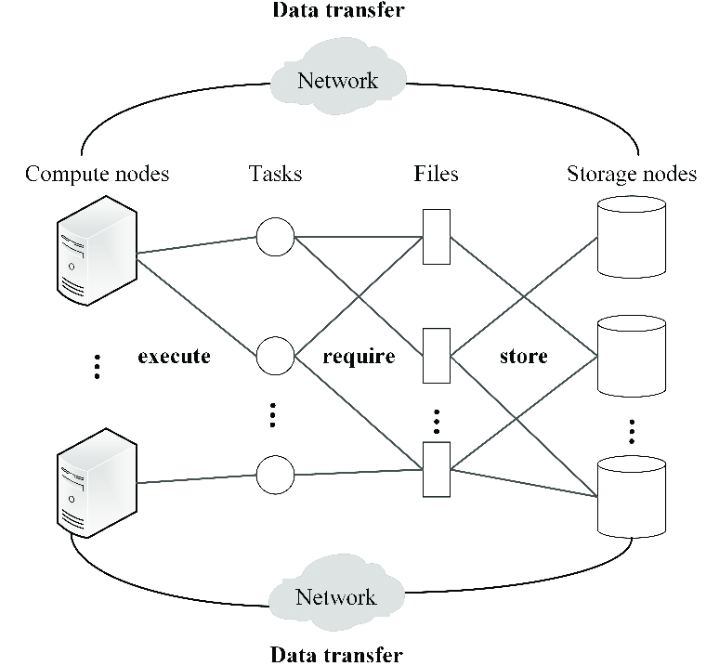
Introduction
Presenter : Mohammad Asifur Rahman Shuvo (21266010)
Data Intensive Computing
Distributed file system
Big Data
Why big data become so big?

Slide 3
Distributed File System(DFS)
As there has been exceptional growth in network-based computing, client/server-based applications have brought revolutions in the process of building distributed file systems.
Reason to Use:
Read large file fast.
Fall tolerance
Efficient and Well managed data.
Transparency
DFS was developed in the first place – the system can still have that integrity if a few workstations get moved around.DFS systems, like other systems, continue to innovate. With new kinds of networking controls and virtualization systems, modern DFS will often take advantage of logical partitioning or other advances in hardware and software. Ex: GFS (Google, 2003),HDFS (Apache Software Foundation, 2006).

Slide 4
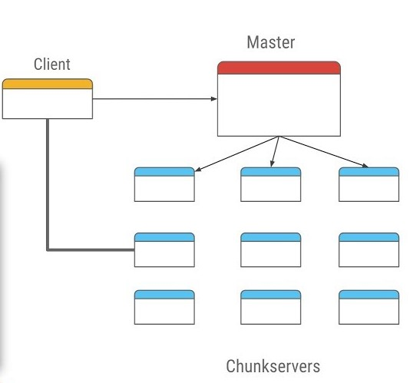
Google File System (GFS) Presenter : Badhan Saha (21266003)
Platform created by tech giant Google.
Turned servers into distributed, reliable and scalable system.
Key Features:
Serve cloud services effectively.
Provide extremely high read and transfer speed on large files.
Data replications across the network.
Chunks of files into multiple chunk server.
Chunks Index controlled by a master server.

Slide 5
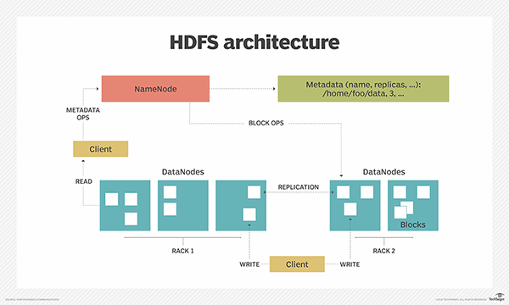
HADOOP DISTRIBUTED FILE SYSTEM (HDFS)
Similarities with other DFS
What makes it different than other DFS?
Highly fault Tolerance
Can be install into low-cost hardware
Provides high throughput access
Suitable for apps to have large datasets
Block Level replication
Node: NameNode & DataNode

Slide 6

Presented By:
Name: Tamanna Kaiser
ID: 18201137
What is a Cluster?
A group of interconnected computers
HADOOP Cluster
is a special type of computational cluster
The limitation of HDFS?
Not a POSIX file system.
Not designed for small files.
Not a platform for relational database.
Not focused on security, encryption or multi tenancy
Conclusion

Slide 7
Thank You.

